Slide 1

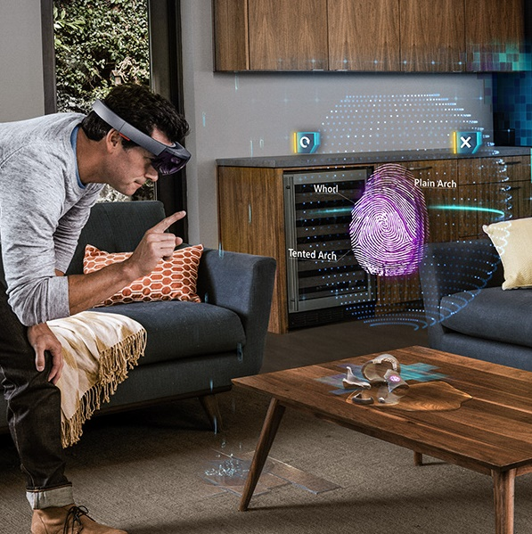

US AI Ambassador Airlift
February 6th-7th, 2019 // Seattle Marriott Bellevue
Image Classification with Deep Learning
Graeme Malcolm – graeme.malcolm@microsoft.com

Slide 2
Session Overview
Introduction to Deep Learning
Neural Networks
Deep Learning Frameworks and Tools
Computer Vision Fundamentals
Types of Computer Vision Model
Image as a Data Type
Image Classification
Convolutional Neural Networks (CNNs)
Hands-On: Building an Image Classifier
PyTorch
Or
Keras
Notes:
In this session, you’ll learn the basic principles of deep learning and computer vision, focusing on the use of convolutional neural networks for image classification. You’ll also learn how to use Microsoft Azure with industry-standard open source deep learning frameworks to train and deploy machine learning models.
After learning about the core concepts, you’ll get a hands-on opportunity to build an image classifier using your choice from the popular Keras or PyTorch deep learning frameworks.

Slide 3
Label
Features
y = f (x )

Slide 4
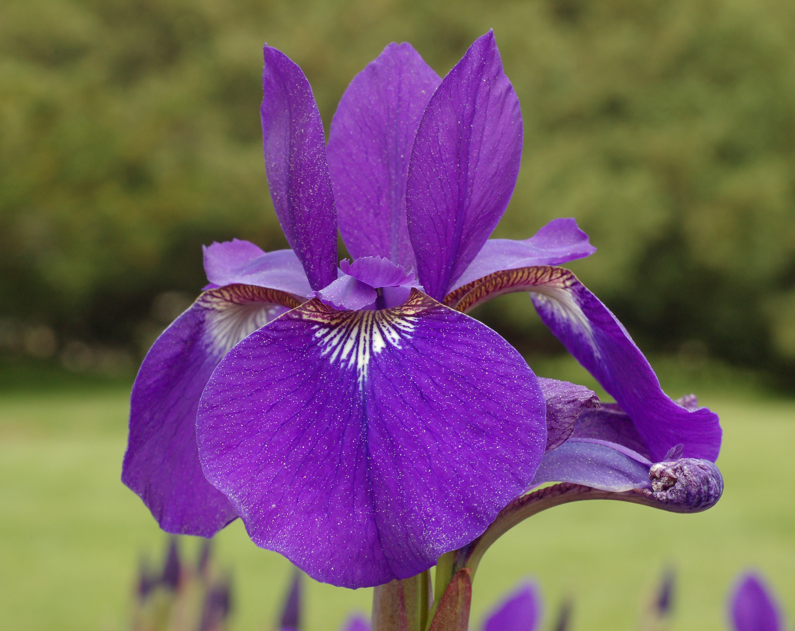
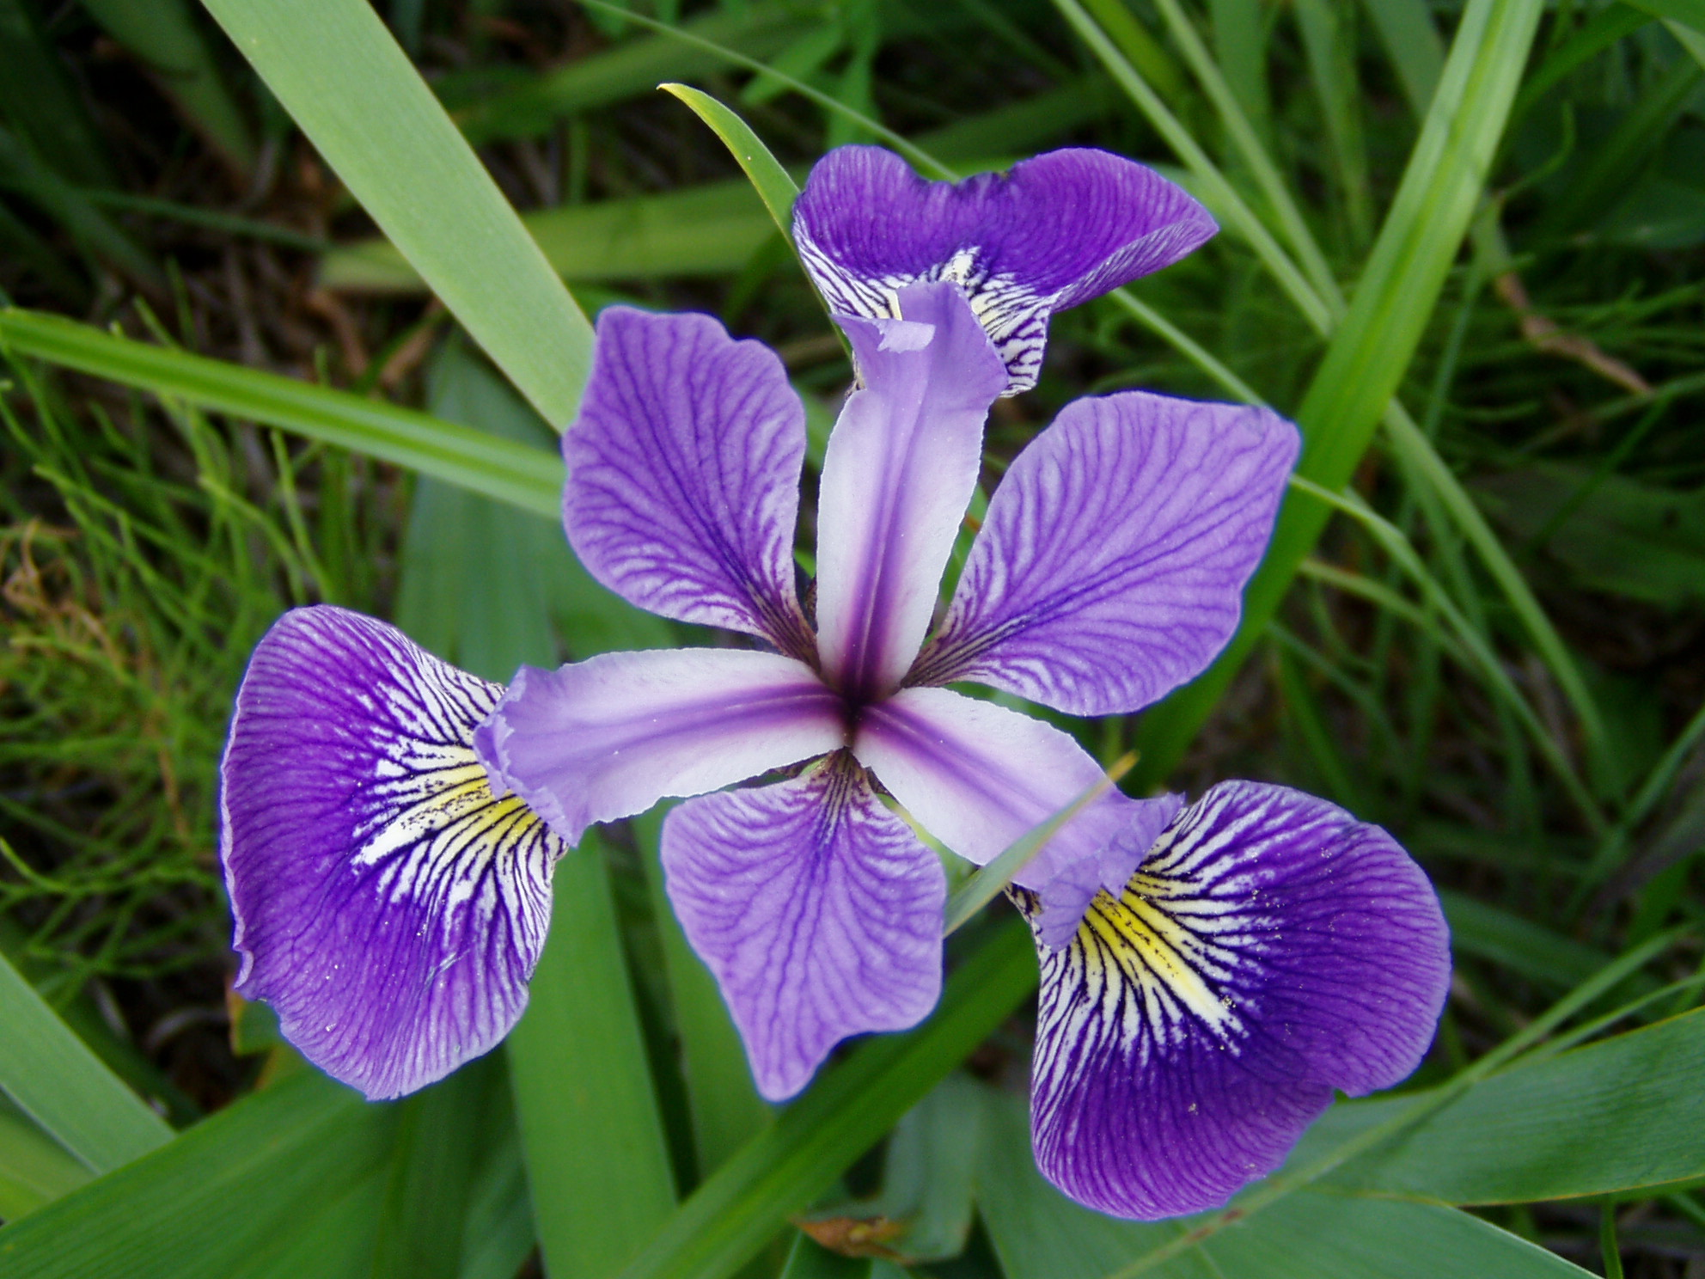
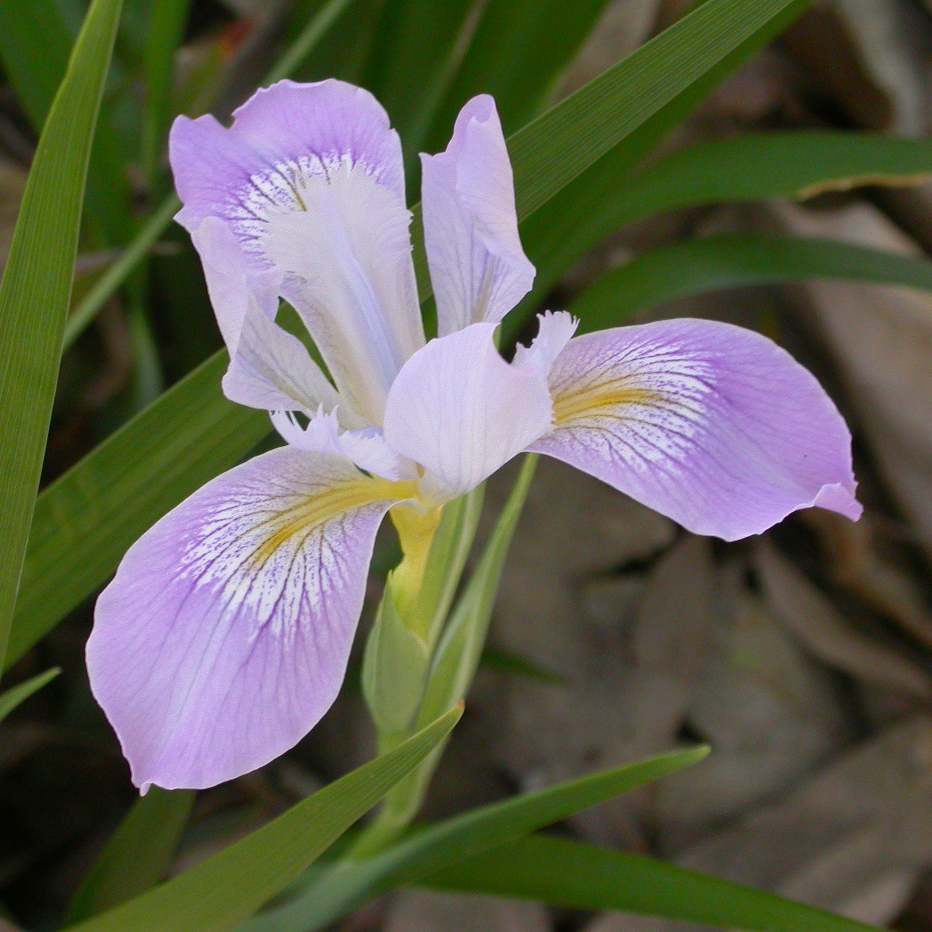
Species
Sepal / Petal Measurements
0 (“Setosa”)
1 (“Versicolor”)
2 (“Virginica”)
[6.6, 3.2, 5.8, 2.4]
y = f (x )
= [0, 1, 0]

Slide 5
b
w₁
x₁
y
∫
( )
f (x,w )
f (x,w,b )
x₂
∑
(xxw)+b
w₂

Slide 6
Neural Network (Perceptron)
6.6
3.2
5.8
2.4
∫∑(xw)+b
0.3
∫∑(xw)+b
∫∑(xw)+b
0.4
= [0.3, 0.4, 0.3]
∫∑(xw)+b
∫∑(xw)+b
[0.0, 1.0, 0.0]
0.3
∫∑(xw)+b
∫∑(xw)+b
Loss = 0.16
Loss = μ(0.3, 0.6, 0.3)²

Slide 7
1
Loss
0
1
2
3
w₁

Slide 8
Loss

Slide 9
Backpropagation
6.6
3.2
5.8
2.4
∫∑(xw)+b
∫∑(xw)+b
0.2
0.3
∫∑(xw)+b
∫∑(xw)+b
∫∑(xw)+b
∫∑(xw)+b
= [0.3, 0.4, 0.3]
0.7
= [0.2, 0.7, 0.1]
∫∑(xw)+b
0.4
∫∑(xw)+b
∫∑(xw)+b
[0.0, 1.0, 0.0]
∫∑(xw)+b
0.1
0.3
∫∑(xw)+b
∫∑(xw)+b
∫∑(xw)+b
∫∑(xw)+b
Loss = μ(0.2, 0.3, 0.1)²
Loss = 0.04

Slide 10
Training
Backpropagation
Validation
5.2
1.2
4.7
2.1
6.6
3.2
5.8
2.4
6.1
2.4
4.6
1.9
2.1
0.8
7.1
2.3
∫∑(xw)+b
∫∑(xw)+b
0.1
0.2
0.0
0.6
0.0
0.0
0.8
0.1
∫∑(xw)+b
∫∑(xw)+b
∫∑(xw)+b
∫∑(xw)+b
Loss = μ([c₁, c₂, c₃,…])²
0.0
0.7
1.0
0.2
0.0
0.1
∫∑(xw)+b
0.1
0.0
∫∑(xw)+b
∫∑(xw)+b

∫∑(xw)+b
0.0
0.1
0.0
0.2
1.0
0.9
0.1
0.0
∫∑(xw)+b
∫∑(xw)+b
∫∑(xw)+b
∫∑(xw)+b

Slide 11
x
w
b
6.6
3.2
5.8
2.4
6.1
2.4
4.6
1.9
2.1
0.8
7.1
2.3
0.6
0.3
0.4
0.9
0.1
0.2
0.1
0.3
x
+

Slide 12
0 | 0 | 0 | 0 | 0 | 0
0 | 3 | 2 | 2 | 3 | 0
0 | 0 | 2 | 2 | 0 | 0
0 | 0 | 2 | 2 | 0 | 0
0 | 3 | 2 | 2 | 3 | 0
0 | 0 | 0 | 0 | 0 | 0
∫∑(xw)+b
0 | 0 | 0 | 0 | 0 | 0
0 | 3 | 2 | 2 | 3 | 0
0 | 0 | 2 | 2 | 0 | 0
0 | 0 | 2 | 2 | 0 | 0
0 | 3 | 2 | 2 | 3 | 0
0 | 0 | 0 | 0 | 0 | 0
0 | 0 | 0 | 0 | 0 | 0
0 | 3 | 2 | 2 | 3 | 0
0 | 0 | 2 | 2 | 0 | 0
0 | 0 | 2 | 2 | 0 | 0
0 | 3 | 2 | 2 | 3 | 0
0 | 0 | 0 | 0 | 0 | 0
1.0
0 | 0 | 0 | 0 | 0 | 0
0 | 3 | 2 | 2 | 3 | 0
0 | 0 | 2 | 2 | 0 | 0
0 | 0 | 2 | 2 | 0 | 0
0 | 3 | 2 | 2 | 3 | 0
0 | 0 | 0 | 0 | 0 | 0
∫∑(xw)+b
∫∑(xw)+b
0.0
∫∑(xw)+b
∫∑(xw)+b
0.0
∫∑(xw)+b
∫∑(xw)+b

Slide 13
Convolution
0 | 0 | 0 | 0 | 0 | 0
0 | 3 | 2 | 2 | 3 | 0
0 | 0 | 2 | 2 | 0 | 0
0 | 0 | 2 | 2 | 0 | 0
0 | 3 | 2 | 2 | 3 | 0
0 | 0 | 0 | 0 | 0 | 0
1 | 0 | 0
0 | 1 | 0
0 | 0 | 1
5
4
4
3
2
7
4
2
2
4
7
2
3
2
4
5

Slide 14
Pooling (Downsampling)
0 | 0 | 0 | 0 | 0 | 0
0 | 5 | 4 | 4 | 3 | 0
0 | 2 | 7 | 4 | 2 | 0
0 | 2 | 4 | 7 | 2 | 0
0 | 3 | 2 | 4 | 5 | 0
0 | 0 | 0 | 0 | 0 | 0
7 | 7 | 7 | 4
7 | 7 | 7 | 7
7 | 7 | 7 | 7
4 | 7 | 7 | 7
7 | 7 | 7 | 4
7 | 7 | 7 | 7
7 | 7 | 7 | 7
4 | 7 | 7 | 7
7

Slide 15
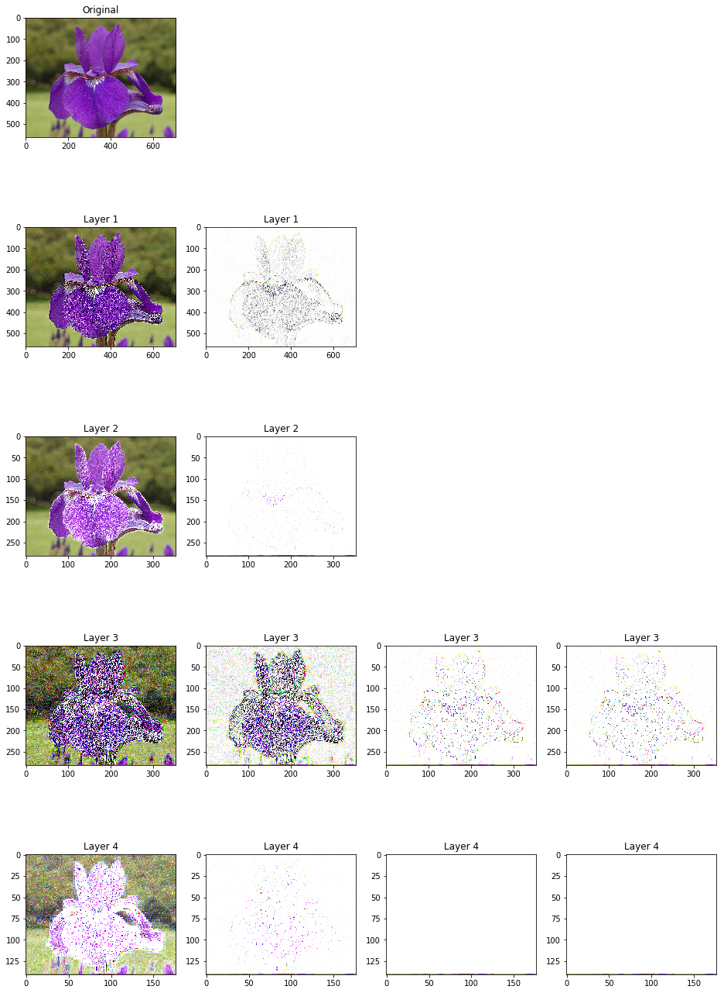
Convolutional Neural Network
0
0
0
0
3
2
0
0
2
∫∑(xw)+b
∫∑(xw)+b
0.8
0 | 0 | 0
0 | 3 | 2
0 | 0 | 2
∫∑(xw)+b
∫∑(xw)+b
0.2
0
0
0
0
3
2
0
0
2
∫∑(xw)+b
∫∑(xw)+b
0.0
0 | 0 | 0
0 | 3 | 2
0 | 0 | 2
∫∑(xw)+b
= [0.8, 0.2, 0.0]
Feature Extraction
Classification

Slide 16

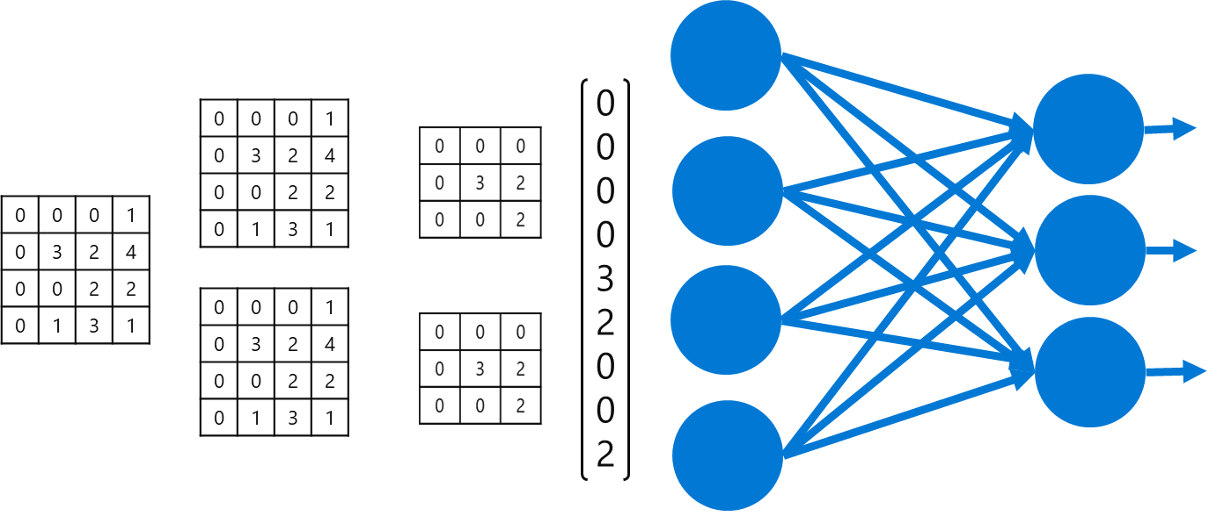

?
Setosa

Slide 17
Lab: Image Classification with Deep Learning
https://aka.ms/imageclasslab

Slide 18
https://aka.ms/mlprimers

